Slide 1
Bank of Baroda Hackathon 2024
Your Team Name : FinFusion
Your team bio : Innovating financial solutions with a fusion of technology and expertise.
Date : 30/6/2024

Slide 2
Problem Statement?
Allowing for a more comprehensive evaluation of risk factor with the help of AI agents , that strive to provide accurate and essential information regarding the financial risk about the borrower , apart from the pure finance based measurements provided the company.
Traditional risk assessment methods employed by banks often rely heavily on historical financial data and basic financial metrics. While these methods provide a foundational understanding, they fall short in capturing the dynamic and complex nature of modern financial environments. The current risk management practices do not adequately address the following challenges:
Data Overload: Banks are inundated with vast amounts of data from various sources. Analyzing these large datasets manually or with conventional methods is time-consuming and prone to human error, making it difficult to identify potential risks and anomalies in real-time.
Predictive Insights: Existing risk management frameworks lack the capability to provide accurate predictive insights. This limitation hinders banks from anticipating market, credit, and operational risks effectively.
Dynamic Risk Factors: Financial environments are increasingly influenced by non-financial factors such as geopolitical events, market sentiment, and regulatory changes. Current methods do not fully integrate these factors into risk assessments.
Regulatory Compliance: Ensuring compliance with ever-evolving regulatory requirements is challenging. Traditional risk management approaches may not be agile enough to adapt to new regulations promptly.

Slide 3
Prerequisite
What are the alternatives/competitive products for the problem you are solving?
Accenture Risk Analytics Platform:
Cloud-based risk management solution.
Offers AI-driven risk assessment and predictive analytics.
Provides customizable risk models and reporting capabilities,
Moody's Analytics Risk Management Solutions:
Offers credit risk assessment and management tools.
Provides stress testing and scenario analysis capabilities.
Includes regulatory reporting and compliance features.
SAS Risk Management:
Comprehensive risk analytics platform.
Offers credit risk, market risk, and operational risk management solutions.
Includes predictive modeling and stress testing capabilities.

Slide 4
Tools or resources
Microsoft Azure Tools
Azure Machine Learning:
Build, train, and deploy machine learning models.
Automate model retraining and deployment.
Integrate with other Azure services for seamless operations.
Azure Synapse Analytics:
Analyze large datasets in real-time.
Integrate data ingestion, data preparation, and data management.
Provides insights using powerful analytics capabilities.
Azure Cognitive Services:
Pre-built AI models for text, speech, vision, and decision-making tasks.
Enhance the analysis of unstructured data.
Integrate AI capabilities directly into applications.
GPT-4 for Advanced Text Analysis:
Generate predictive insights and analyze textual data.
Provide detailed explanations and reports on risk factors.
Automate the generation of mitigation strategies and recommendations.
Agentic Workflows:
Implement agentic workflows using GPT-4 for iterative task refinement.
Enable the AI to autonomously set goals, plan, and execute tasks.
Utilize multi-agent collaboration for enhanced decision-making and problem-solving.

Slide 5
Any Supporting Functional Documents
1. Real-time risk insights and anomaly detection :-
Continuously analyzes market trends, credit data, and operational metrics.
Instantly identifies outliers and potential risks, alerting stakeholders for swift responses, minimizing losses, and maximizing opportunities.
2. Adaptive risk mitigation strategies :-
AI dynamically generates and refines strategies based on current conditions.
Considers market volatility, economic indicators, and geopolitical events for tailored actions that evolve with changing circumstances.
3. Automated regulatory compliance :-
Integrates current regulatory requirements, performing continuous checks and flagging compliance issues.
Adapts to new regulations, reducing non-compliance risks and streamlining the reporting process.
4. Holistic borrower risk profiles :-
Incorporates diverse data sources beyond traditional credit scores for a comprehensive risk picture.
Uses social media activity, industry trends, and behavioral patterns to uncover issues missed by conventional methods, enabling informed lending decisions.
5. Proactive risk management :-
Utilizes predictive analytics and machine learning to forecast potential risk scenarios and stress-test portfolios.
Prepares the bank for future risks, optimizing risk management strategies accordingly.

Slide 6
Key Differentiators & Adoption Plan
How is your solution better than alternatives and how do you plan to build adoption?
Your Azure-based solution offers key advantages over Wolters Kluwer OneSumX:
Greater flexibility and customization
More advanced AI capabilities with GPT-4 and agentic workflows
Scalability through Azure's cloud infrastructure
Seamless integration with Microsoft ecosystem
Real-time big data analytics
Continuous improvement via automated model retraining
Potential cost-effectiveness with pay-as-you-go model
Multi-agent collaboration for comprehensive risk assessment
To build adoption:
Start with a pilot program
Provide thorough training and support
Implement a phased rollout
Showcase early successes
Engage key stakeholders
Demonstrate enhanced compliance capabilities
Ensure smooth integration with existing workflows
Gather feedback and iterate continuously
Clearly demonstrate ROI
Implement effective change management strategies
This approach offers a more adaptable and future-proof solution compared to off-the-shelf products, with the key being effective communication of benefits and smooth implementation.

Slide 7
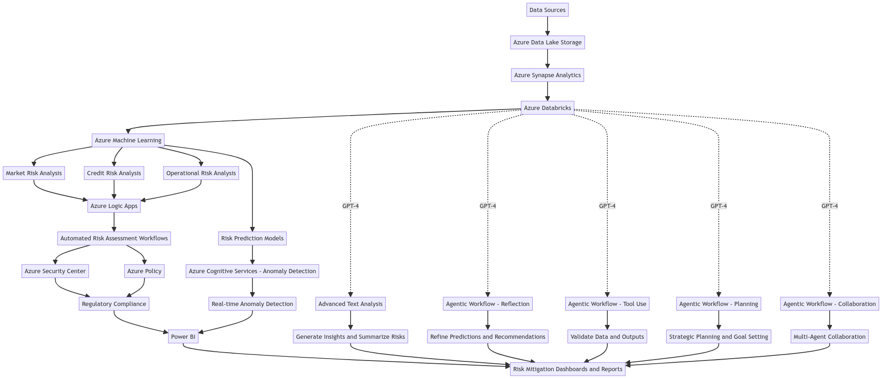
Flowchart

Slide 8
Business Potential and Relevance
What are the business applications of the problem you are solving?
Credit risk assessment
Market risk management
Operational risk mitigation
Regulatory compliance automation
Strategic decision-making support
Customer risk profiling
Liquidity risk management
Reputational risk management
Investment portfolio optimization
These applications enhance overall risk management, enabling more informed decisions and proactive risk mitigation across banking operations.

Slide 9
Uniqueness of Approach and Solution
What is the unique aspects of the proposed idea?
Integration of cutting-edge AI (GPT-4) with cloud infrastructure
Agentic workflows for autonomous problem-solving
Multi-agent collaboration for enhanced decision-making
Seamless integration of various Azure tools for comprehensive risk management
Real-time big data analytics combined with advanced predictive capabilities
Customizable and scalable architecture tailored to specific banking needs
Continuous model improvement through automated retraining
Flexible pay-as-you-go model for cost-effectiveness
This approach offers a more adaptable, powerful, and future-proof solution compared to traditional off-the-shelf risk management products.

Slide 10
User Experience
How will your idea enhance the user experience?
Intuitive interfaces: Azure's tools offer user-friendly dashboards and visualizations.
Real-time insights: Immediate access to risk analytics and predictions.
Automated reporting: Reduces manual work and potential errors.
Personalized recommendations: AI-driven suggestions tailored to specific roles.
Streamlined workflows: Integration with existing systems for seamless operations.
Natural language interaction: GPT-4 enables more intuitive querying and analysis.
Mobile accessibility: Cloud-based solution allows access from various devices.
Customizable alerts: Users can set personalized risk thresholds and notifications.
Collaborative features: Facilitates easier information sharing across teams.
Continuous learning: System improves over time, adapting to user needs and patterns.

Slide 11
Scalability
How effectively can your solution be scaled to accommodate growth without compromising performance?
Cloud infrastructure: Azure's elastic resources can easily expand to meet growing demands.
Microservices architecture: Allows independent scaling of specific components.
Auto-scaling: Automatically adjusts resources based on workload.
Distributed processing: Synapse Analytics enables efficient handling of large datasets.
Global data centers: Allows geographical distribution for improved performance.
Containerization: Facilitates easy deployment and scaling of applications.
Load balancing: Optimizes resource utilization across multiple instances.
Caching mechanisms: Improves performance for frequently accessed data.
GPT-4 scalability: Handles increasing complexity and volume of language tasks without performance degradation, adapting to growing analytical needs.
.
This architecture ensures the solution can grow with your bank's needs while maintaining performance and reliability.

Slide 12
Ease of Deployment and Maintenance
Data Ingestion and Storage:
Automate data ingestion into Azure Data Lake Storage using Azure Data Factory.
Data Processing and Analytics:
Configure Azure Synapse Analytics for seamless data integration and real-time processing.
Machine Learning Model Deployment:
Use Azure Machine Learning for automated model training, deployment, and retraining.
Risk Analysis and Workflow Automation:
Deploy Azure Logic Apps and Cognitive Services to automate risk assessment workflows.
Visualization and Compliance Management:
Set up Power BI for real-time dashboards and Azure Security Center for compliance monitoring.
Use GPT-4 for Advanced Analysis:
Implement GPT-4 for insights, task refinement, and multi-agent collaboration to enhance decision-making and efficiency.

Slide 13
Security Considerations
To ensure security and integrity, our solution incorporates:
Azure Security Center for comprehensive threat protection
End-to-end encryption for data in transit and at rest
Role-based access control (RBAC) to manage user permissions
Regular security audits and penetration testing
Automated compliance checks against industry standards
Multi-factor authentication for all user access points
Continuous monitoring and logging of system activities
Secure API gateways for external integrations
Data masking and anonymization techniques for sensitive information
Regular security patches and updates across all components

Slide 14
Thank You
Team members:-
Ayan Sheikh
Arnav Joglekar
Naman Sarda
Vedarth Ambilkar

